Slide 1
Chilled Beam Performance:
1 Shelly Street, Sydney

Slide 2
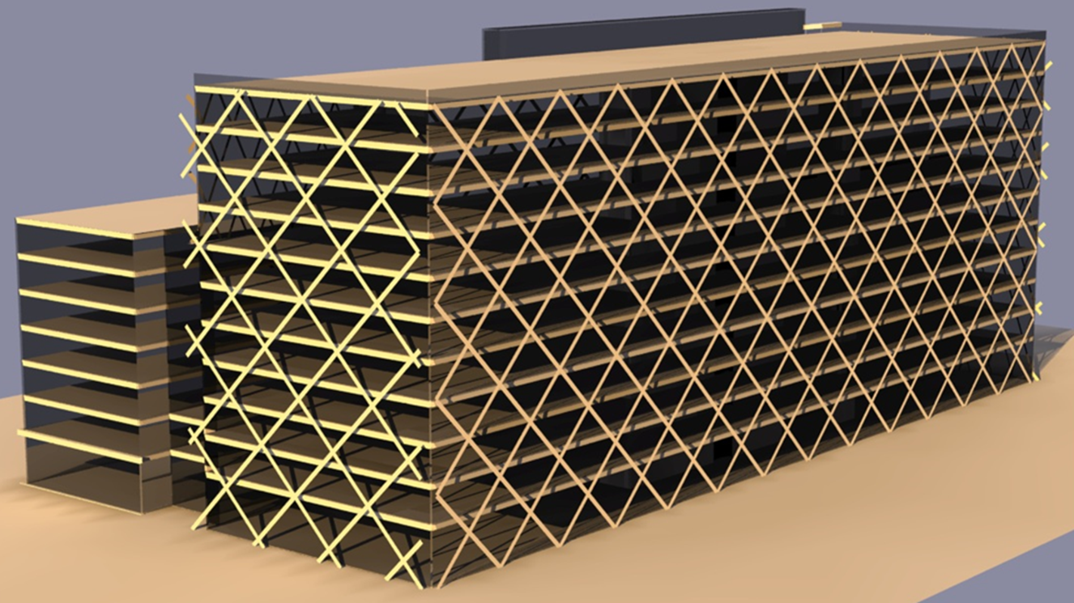
1 Shelley Street, Sydney
3D Model Creation

Slide 3
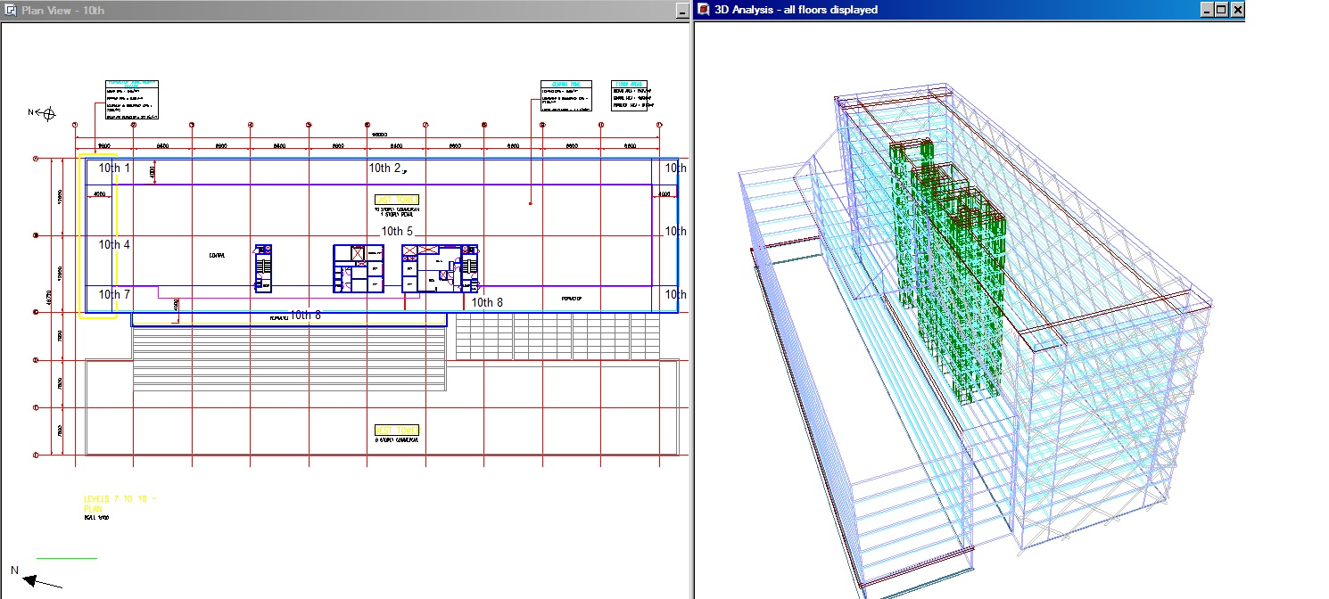
1 Shelley Street, Sydney
3D Model Creation

Slide 4
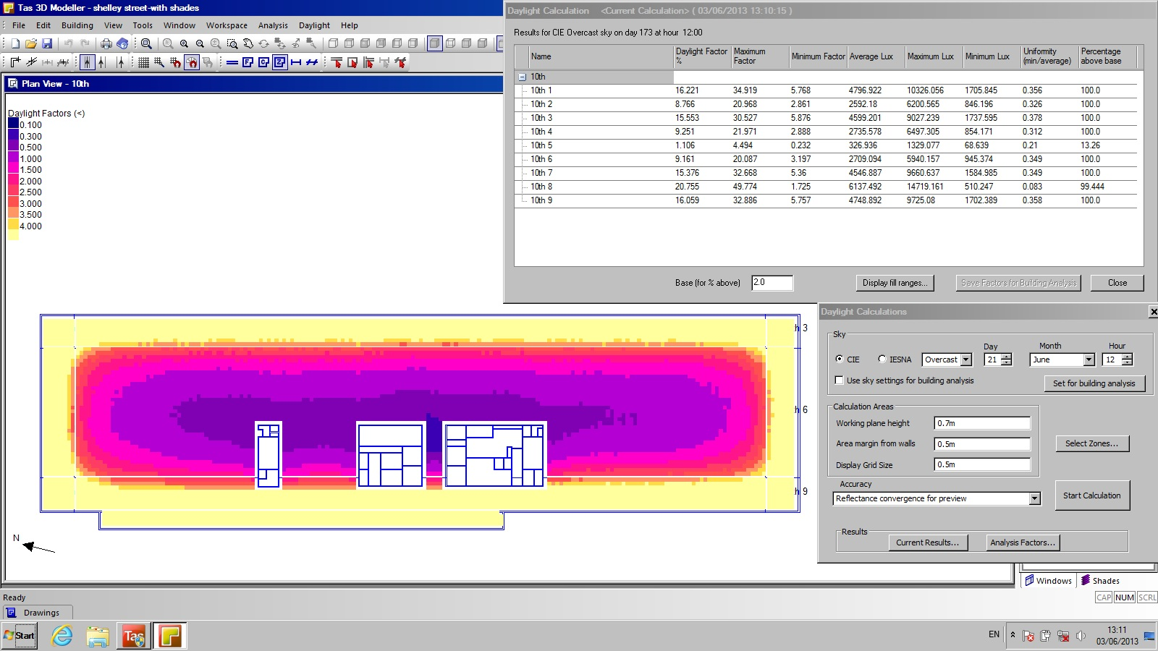
1 Shelley Street, Sydney
Daylight Analysis

Slide 5
1 Shelley Street, Sydney
HVAC Systems: Performance Comparison
VAV fancoil
Active chilled beam
Passive chilled beam (95% convective / 5% radiant absorption)
Passive “Radiant” chilled beam (65% convective / 35% radiant absorption)
Traditional VAV
Modern VAV (temperature and CO2 control with “static reset”)

Slide 6
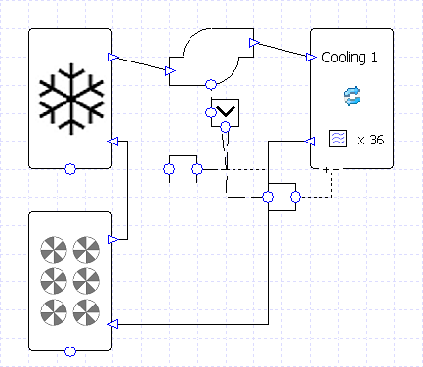
Systems Setup
Cooling circuit (common to all air side systems)
Chiller has a COP of 4 (typical chiller performance based on flow of 6°C and return temp of 12°C).
Addition of Dry Air Cooler for free cooling when available. DAC efficiency = 67%, SFP of fans = 0.4W/l/s
1 Shelly St - Sydney

Slide 7
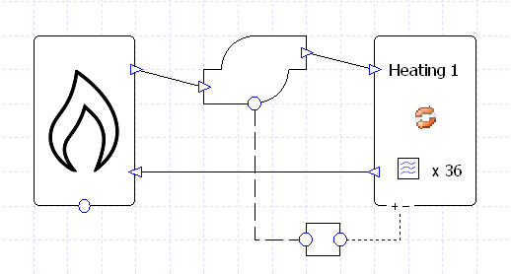
Systems Setup
Heating circuit (common to all air side systems)
Boiler has an efficiency of 90% and a flow set point of 65°C.
DHWS also fed from this circuit.
1 Shelly St - Sydney

Slide 8
Systems Setup
DX circuit - common to all air side systems
Nominal heating energy input ratio 0.261 (COP = 3.83)
Nominal cooling energy input ratio 0.307 (COP = 3.26)
(Performance taken from typical Mitsubishi VRF heat recovery unit)
1 Shelly St - Sydney

Slide 9
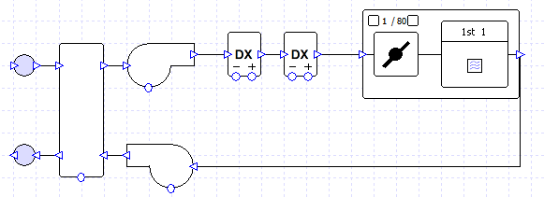
Systems Setup
VAV fancoil
A high efficiency chiller supplies chilled water at 6°C to the fan coils with a nominal return temperature of 12°C.
An air source heat pump supplies heating and cooling to the DX coils in the AHU
AHU based on total SFP of 1.8 W/l/s, includes heat recovery at 75% efficiency, provides air to the fan coil units at 14°C.
The fresh air flow rate is 2.2 l/s/m² for perimeter zones and 1.1 l/s/m² for core zones.
The fan coil units include EC motors and VAV control and have an SFP of 0.25 W/l/s.
The fan coil units have a minimum flow turndown to 60% of the maximum flow rate.

Slide 10
Systems Setup
Active Chilled Beam
Dedicated high efficiency chiller supplies 14°C water to chilled beams
Incorporates “Free Cooling” circuit
When outdoor conditions permit, chiller can turn off.
During other times, free cooling runs in conjunction with chiller to further reduce energy usage.
Variable pump speed to ensure chilled water return is 3K higher than the supply.
(continued next slide)

Slide 11
Systems Setup
Active Chilled Beam
(continued from previous slide)
DX cooling coil provides conditioned air at 16°C
Dehumidifies supply air to control latent gains within the space
Maintains dew point at 1.0°C lower than chilled water flow temperature onto beams.
DX heating coil provides the conditioned air at 13°C, supplies reheat during dehumidification.
AHU based on a total SFP of 1.8 W/l/s, includes heat recovery at 75% efficiency.
Fresh air flow rate = 2.2 l/s/m² for perimeter zones & 1.1 l/s/m² for core zones.

Slide 12
Systems Setup
Passive Chilled Beam (common to both radiant & convective)
Two passive chilled beam systems modelled: 5% radiant proportion, 35% radiant proportion.
To compensate for lower resultant temperatures, room thermostat cooling setpoint increased by 1°C for the 35% system.
Dedicated high efficiency chiller supplies 15°C water to chilled beams
Incorporates “Free Cooling” circuit
When outdoor conditions permit, chiller can turn off.
During other times, free cooling runs in conjunction with chiller to further reduce energy usage.
Variable pump speed to ensure chilled water return is 3K higher than the supply.
(continued next slide)

Slide 13
Systems Setup
Passive Chilled Beam (common to both radiant & convective)
(continued from previous slide)
DX cooling coil provides conditioned air at 16°C
Dehumidifies supply air to control latent gains within the space
Maintains dew point at 1.0°C lower than chilled water flow temperature onto beams.
DX heating coil provides the conditioned air at 16°C, supplies reheat during dehumidification.
AHU based on a total SFP of 1.8 W/l/s, includes heat recovery at 75% efficiency.
Fresh air flow rate = 2.2 l/s/m² for perimeter zones & 1.1 l/s/m² for core zones.

Slide 14
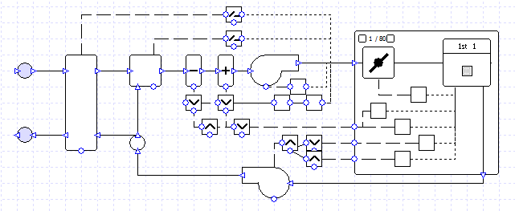
Systems Setup
Traditional VAV
High efficiency chiller supplies chilled water at 6°C to cooling coil with nominal return temperature of 12°C.
VAV system based on a total SFP of 1.8 W/l/s, heat recovery at 75% efficiency, provides air to zones to meet heating & cooling demands.
Fresh air flow rates: 2.2 l/s/m² for perimeter zones, 1.1 l/s/m² for core zones.
Zone dampers configured to control air flow based on zone temperature requirements.
Supply fan controlled to maintain a constant static pressure.

Slide 15
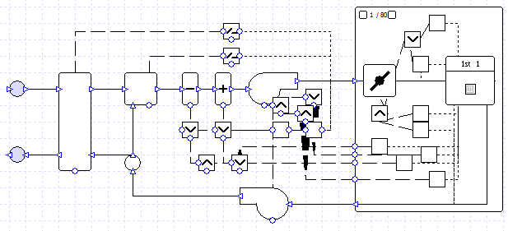
Systems Setup
Modern VAV
High efficiency chiller supplies chilled water at 6°C to cooling coils with nominal return temperature of 12°C.
VAV system based on a total SFP of 1.8 W/l/s, heat recovery at 75% efficiency, provides air to zones based on heating & cooling demand.
Fresh air flow rates: 2.2 l/s/m² for perimeter zones, 1.1 l/s/m² for core zones.
Zone dampers configured to control air flow based on zone temperature requirements and CO₂ levels.
Supply & return fans controlled to give “static pressure reset” as described in ASHRAE 90.1.

Slide 16
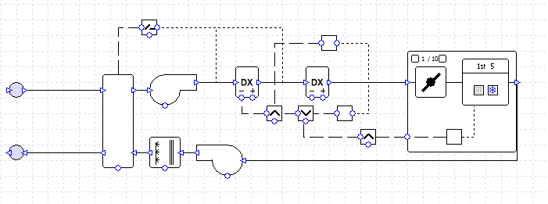
Systems Setup
Frenger Radiant Chilled Beam (A)
Passive chilled (65% convective / 35% radiant absorption) beam air side
Evaporative cooling of exhaust air before heat recovery.

Slide 17
Systems Setup
Frenger Radiant Chilled Beam (B)
Passive chilled (65% convective / 35% radiant absorption) beam air side
Evaporative cooling and sensible heat recovery on fresh air.

Slide 18
Summary
Results Analysis
 | Heating (kWh) | Cooling (kWh) | Auxiliary (kWh) | Total (kWh)
VAV fancoil | 84,504.39 | 541,862.09 | 252,238.47 | 878,604.95
Active beam | 84,468.56 | 529,660.69 | 203,059.41 | 817,188.66
Passive Beam (95% Convective / 5% Radiant absorption) | 87,021.97 | 509,811.69 | 206,553.40 | 803,387.06
Frenger “Radiant” Passive Beam (65% Convective / 35% Radiant absorption) | 86,836.56 | 454,034.25 | 203,257.08 | 744,127.89
Traditional VAV | 365,106.69 | 663,804.59 | 389,736.06 | 1,418,647.34
Modern VAV | 86,167.17 | 609,406.33 | 276,391.29 | 971,964.79
From the above results the Frenger Radiant passive beam system consumes the least energy.
Frenger “Radiant” Passive Beam (65% Convective / 35% Radiant absorption) | 86,836.56 | 454,034.25 | 203,257.08 | 744,127.89
By applying evaporative cooling on the exhaust air further energy savings can be achieved, however when applied to the fresh air system additional energy would be consumed.
Radiant Chilled Beam (A): Evaporative cooling on exhaust air | 88,454.71 | 411,994.34 | 209,178.74 | 709,178.93
Radiant Chilled Beam (B): Evaporative cooling on fresh air | 88,319.67 | 383,777.83 | 282,394.64 | 754,491.95

